Slide 1
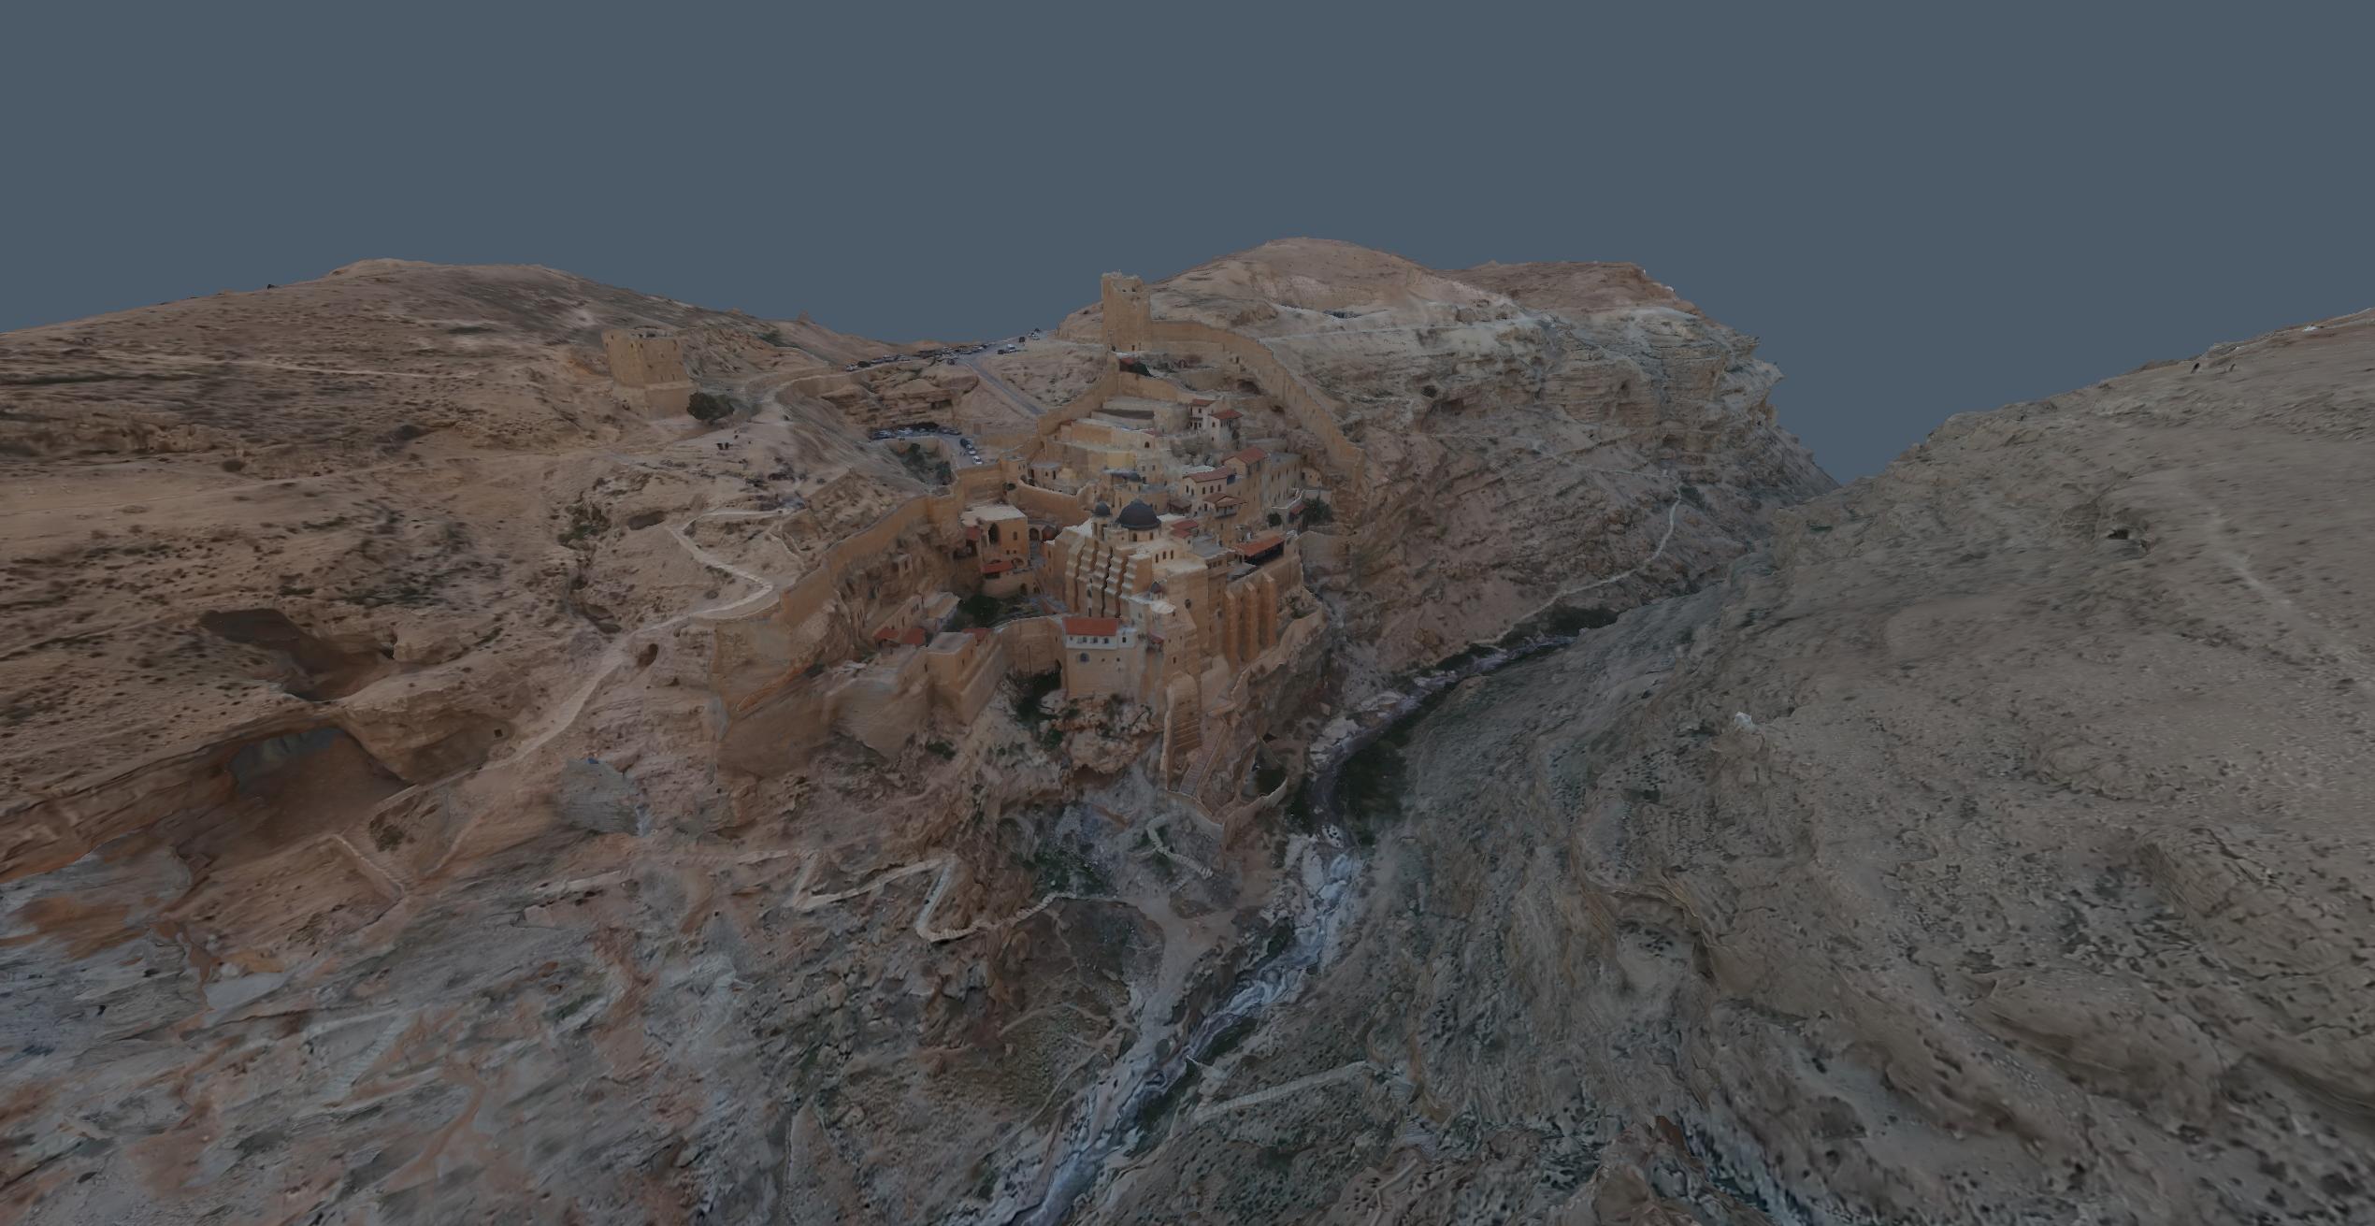
Introduction to rendering with three.js
Alex Zhang
Fraunhofer Workshop 2nd Sep 2021

Slide 2
Overview
Introduction
Tutorial
WebGL and Three.js
The Graphics Pipeline
Coordinate Systems
Perspective Camera
Setup Visual Studio Code
Lights and Shading
Create a cube – Vertex and Index buffers
Shaders – Lambert shading model
Textures
Import a GLTF model
Notes:
1. WebGL and Three.js – What are they used for?
2. The Graphics Pipeline – How geometry data are processed, vertex and index buffers. Learn about the important stages in the rendering pipeline.
3. Coordinate Systems – How mesh vertices are transformed to the clipping coordinate space required by the graphics pipeline.
4. Perspective Camera – How the view and projection matrix is formed and used transforming mesh vertices.
Setup the development environment. Visual Studio Code. Make sure three.js runs on your system.
Try out the three.js defined objects to add a cube mesh, ambient, and direction lights in the scene.
Let’s create your own cube by defining its vertices and indices.
Create your vertex and fragment shader material, using the Lambert shading model, to use in place of the three.js Lambert shader material.
Texture the cube to make it look more like a Minecraft block of dirt. Add the texture coordinates to the mesh.
Use the Three.js GLTF importer to import an awesome looking 3D model.

Slide 3
WebGL and three.js
WebGL – A JavaScript API for 3D graphics rendering
Runs on most modern web browsers
Creates a rendering context within HTML <canvas> element
Three.js – A high-level graphics library based on WebGL
Scene management, cameras, lights, material and shaders, importing models and textures…
The rendering loop:
Passing scene data to the GPU graphics pipeline every frame
Notes:
The heart of rendering is in the rendering loop

Slide 4
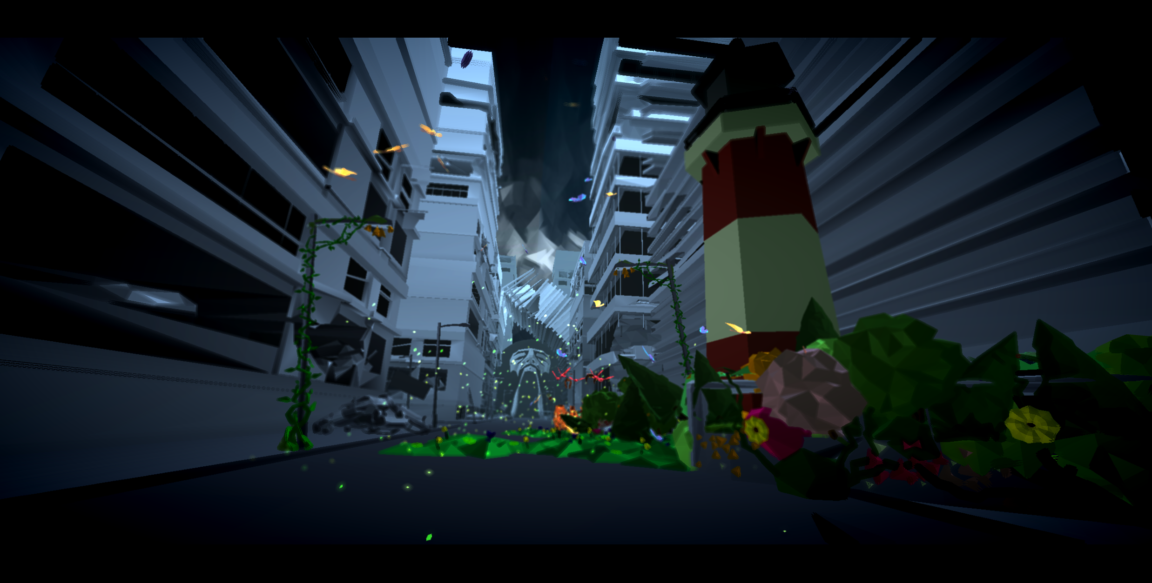
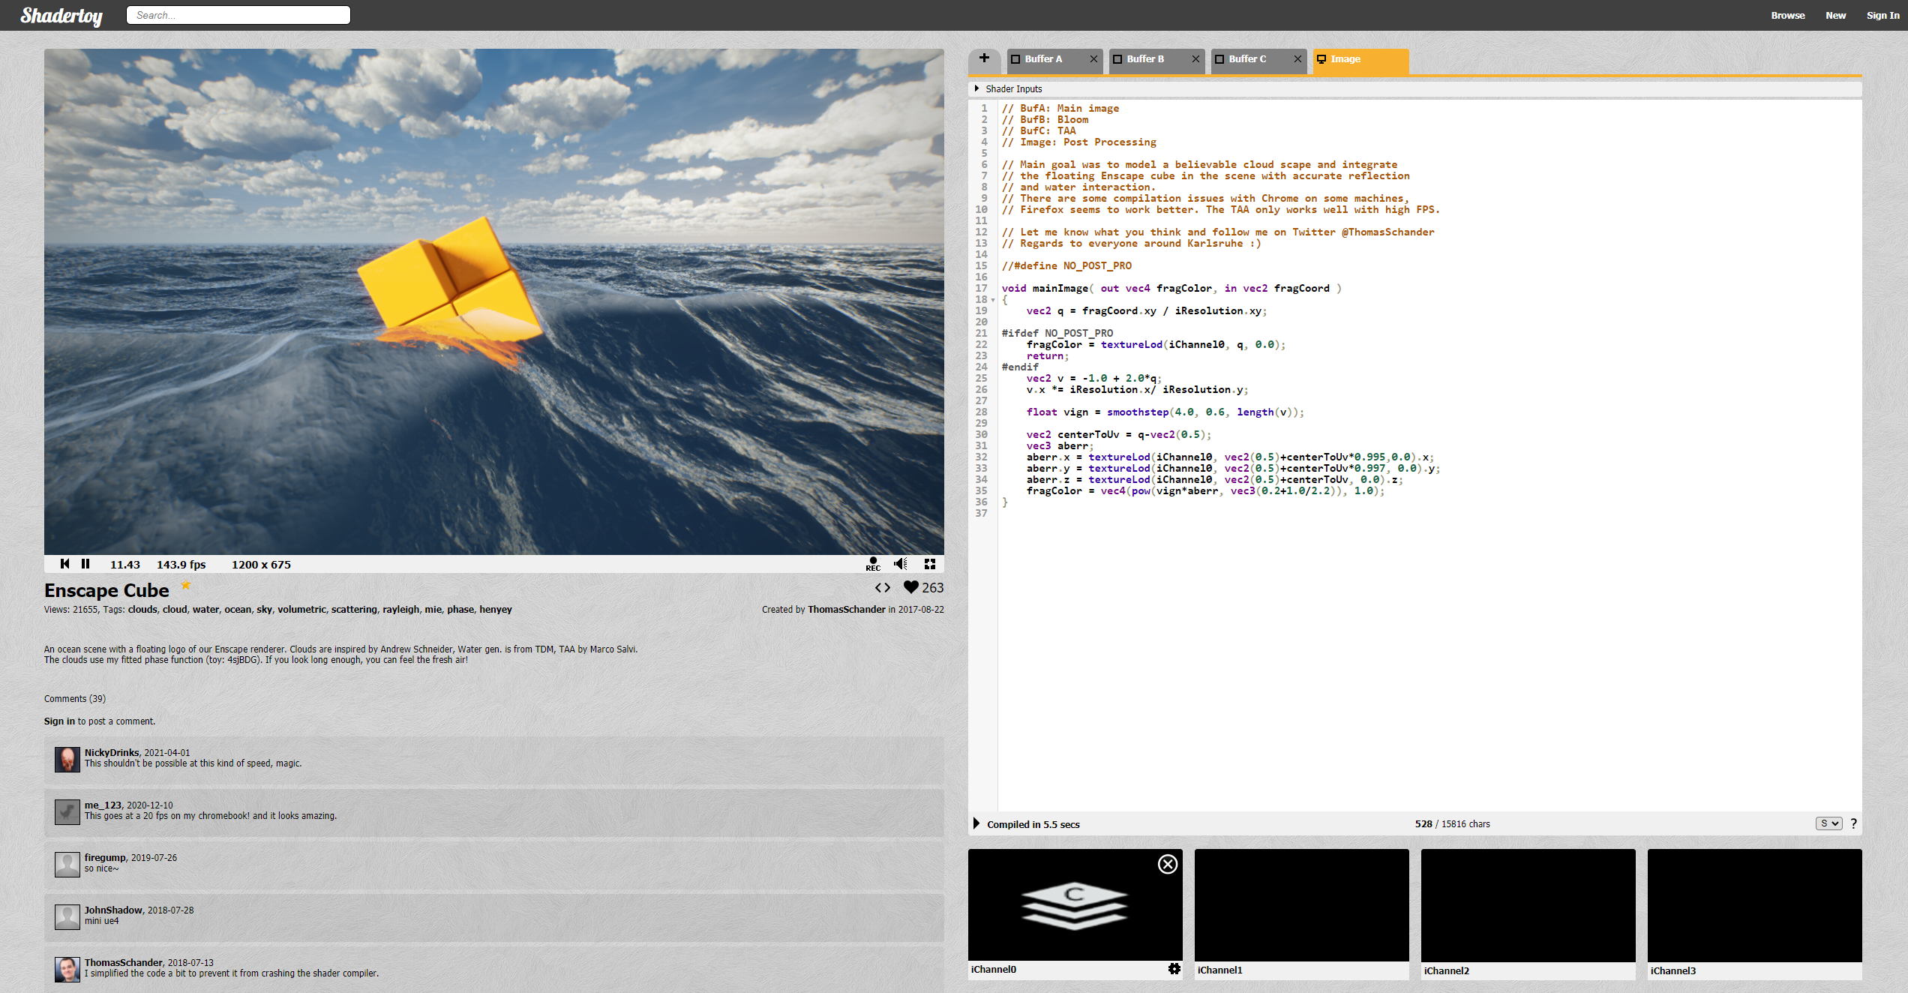
http://www.ro.me/
Interactive music video
https://www.shadertoy.com/
Complex rendering

Slide 5
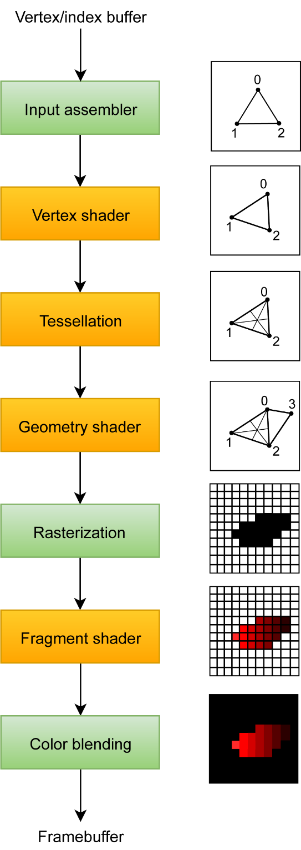
The Graphics Pipeline
Input
A list of mesh vertices (XYZ coordinates)
Three vertices form one triangle primitive
Output
Computed fragment colors (RGB values) of the visible mesh from a particular view
RGB values (Image) stored in the framebuffer
Vertex and fragment shaders are mandatory
https://vulkan-tutorial.com/Drawing_a_triangle/Graphics_pipeline_basics/Introduction
Notes:
Pipeline has series of stages where each receives and input and passes output data to the following stage.
The input assembler collects the raw vertex data from the buffers you specify and may also use an index buffer to repeat certain elements without having to duplicate the vertex data itself.
The tessellation shaders allow you to subdivide geometry based on certain rules to increase the mesh quality
The geometry shader is run on every primitive (triangle, line, point) and can discard it or output more primitives than came in.

Slide 6
Rendering Pipeline Stages
Vertex buffer
An array of coordinate set describing a vertex attribute for each vertex of the model
Vertex attributes can be positions, normals, texture UV coordinates, colors…
3 contiguous vertices forms 1 triangle primitive
 | Array 1 | Array 2 | Array 3
Vertex 1 | {x, y, z} | {u, v} | {r, g, b}
Vertex 2 | {x, y, z} | {u, v} | {r, g, b}
Vertex 3 | {x, y, z} | {u, v} | {r, g, b}
… | … | … | …
https://vulkan-tutorial.com/Drawing_a_triangle/Graphics_pipeline_basics/Introduction

Slide 7
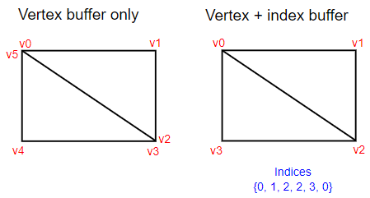
Rendering Pipeline Stages
Index buffer
An array of indices addressing vertices in the vertex buffer to describe the model
Reuse existing vertices to reduce vertex data size
Addressed vertex attributes are input to the vertex shader
 | Array 1
Index 1 | 3
Index 2 | 1
Index 3 | 2
… | …
https://vulkan-tutorial.com/Vertex_buffers/Index_buffer
https://vulkan-tutorial.com/Drawing_a_triangle/Graphics_pipeline_basics/Introduction

Slide 8
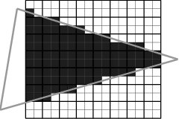
Rendering Pipeline Stages
Vertex shader
A program that executes operation per vertex
Input: Transformation matrices
Transform vertex positions to the clipping coordinate space (expected at the end of the vertex shader)
Rasterization
Discretizes triangle primitives into fragments
Interpolates vertex attributes across the fragments
[Moss, Andrew 2007]
https://vulkan-tutorial.com/Drawing_a_triangle/Graphics_pipeline_basics/Introduction
Notes:
Vertex shader processes individual vertices

Slide 9
Rendering Pipeline Stages
Fragment shader
A program that executes operation per fragment
Usually to compute shading functions
Example inputs to shading functions:
Color values (RGB) sampled from a texture
Color values of the light or object material
Color values passed from vertex shader
Equation parameters (light intensity etc.)
Output: The color value of each fragment
https://vulkan-tutorial.com/Drawing_a_triangle/Graphics_pipeline_basics/Introduction

Slide 10
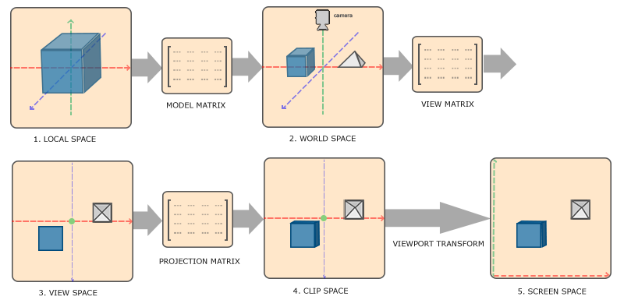
Coordinate Systems
Vertex coordinates are transformed through a series of coordinate systems (spaces)
Certain operations are easier performed in a coordinate space
Organised scene management with many objects
https://learnopengl.com/Getting-started/Coordinate-Systems
Notes:
Remember how the vertex shader requires all vertices to be transformed to clip space at the end of the vertex shader stage
Objects attached to other objects

Slide 11
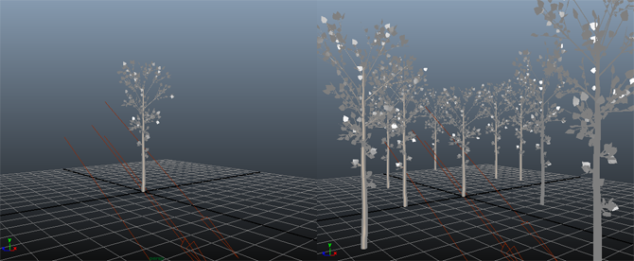
Model matrix
Transforms mesh objects from local (object) space to world space
Each mesh has its own model matrix
Place meshes in the world (or scene) at a position, scale, and orientation
Linear transformations: scaling, rotation, translation
https://www.scratchapixel.com/lessons/3d-basic-rendering/transforming-objects-using-matrices

Slide 12
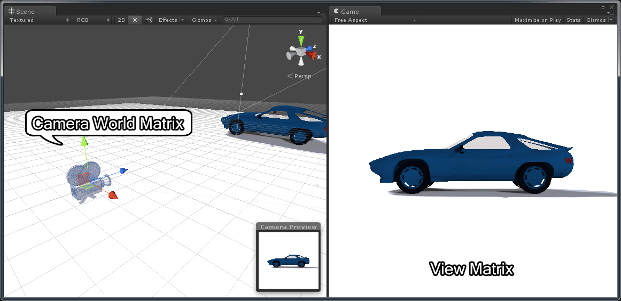
View matrix
Transforms mesh objects from world space to view (or camera) space
Places meshes to be viewed from a camera inside the world
Defines the camera position and orientation
https://www.3dgep.com/understanding-the-view-matrix/

Slide 13
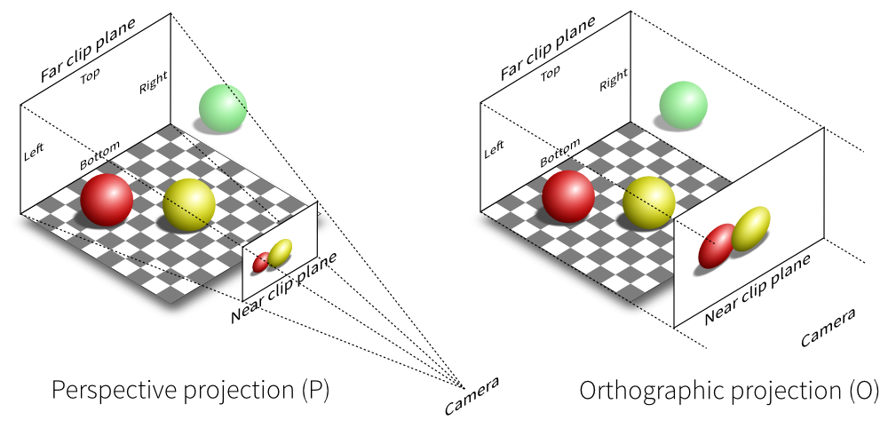
Projection matrix
Transforms mesh objects from view space to clip space
Defines a viewing volume
Vertices or primitives outside of this volume is clipped and not rasterized
Defined by the field of view (FOV) (for perspective projection) and the aspect ratio of the near clip plane
Projects 3D coordinates to the 2D plane
http://vispy.org/modern-gl.html

Slide 14
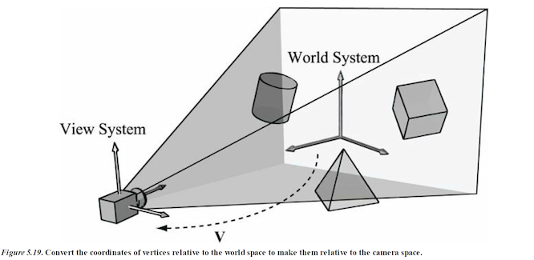
Perspective camera system
Define the view matrix and projection matrix
View matrix components
View position (view point)
View direction (image plane normal)
Up vector (world Y or Z axis)
Perspective projection matrix components
Field of view
Aspect ratio of image plane
Near and far planes
Their distance to view point
http://ycpcs.github.io/cs470-fall2014/labs/lab07-2.html
Notes:
Perspective – objects of the same size appear smaller when farther and larger when nearer

